Slide 1
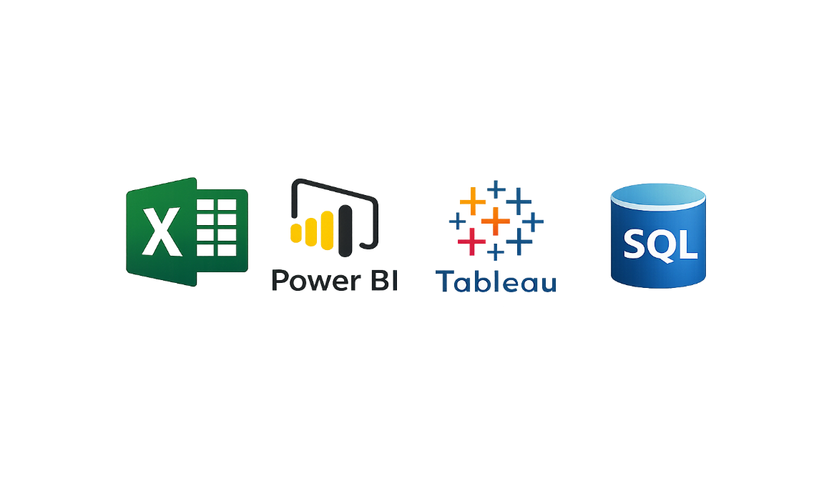

HR Analytics Dashboard Portfolio
Tools
Excel | Power BI | Tableau | SQL
Domain
Human Resources Analytics
BY
1. Soubhagya Kumar Burma
2. Rutuja Gaikwad
3. B R Shanmukhi
4.KANAMARLAPUDI SAILAKSHMI
5. Manisha Vaidya
6. Yusuf has patel
7. Muhammed shibinuu
Notes:
NOTE:
To change the image on this slide, select the picture and delete it. Then click the Pictures icon in the placeholder to insert your own image.

Slide 2
Project Overview
Objective: To analyse employee attrition patterns and identify key workforce trends affecting retention.
Datasets Used: HR_1 and HR_2 datasets containing approximately 50,000 employee records.
Approach: Kpis are designed and aligned with real-world business and HR decision-making.
Common KPIs Across Dashboards:
Average attrition rate by department
Average hourly rate (male – research scientist)
Attrition vs monthly income
Average working years by department
Job role vs work–life balance
Attrition vs years since last promotion

Slide 3
EXCEL HR ANALYTICS
Tool: Microsoft Excel
Techniques Used:
Pivot Tables
Pivot Charts
Advanced Excel Formulas
Data Cleaning & Formatting
Key Insights:
Attrition varies significantly across departments.
Higher attrition in early working years (0–3 years).
certain job roles show higher attrition risk.
Work–life balance has a noticeable impact on employee retention.
Conclusion:
This dashboard provides a high-level overview of workforce size, attrition patterns, and employee experience.
It helps identify high-risk departments and job roles requiring HR intervention.

Slide 4
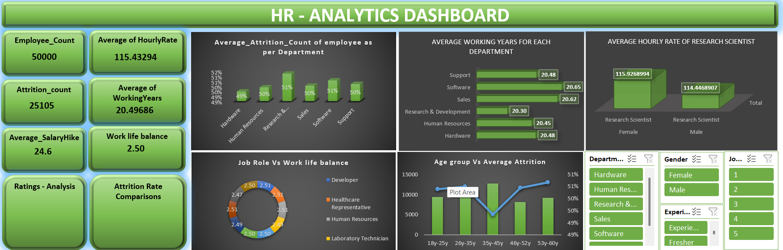
Excel Dashboard

Slide 5
Power bi hr analytics
Tool: power bi Techniques: Power Query, Data Modeling, DAX.
Power BI HR Analytics – Insights:
Interactive dashboards reveal hidden attrition trends.
Age group 26–35 shows the highest attrition.
Salary slabs below average show higher employee exits.
Attrition patterns vary across job roles and departments enables role-based retention strategy.
Conclusion:
This dashboard focuses on understanding attrition patterns using income bands, promotions, job roles, and demographics.
It highlights relationships between salary, work–life balance, and career progression with employee exits.
The analysis supports Hrteams in identifying root causes behind attrition trends.

Slide 6
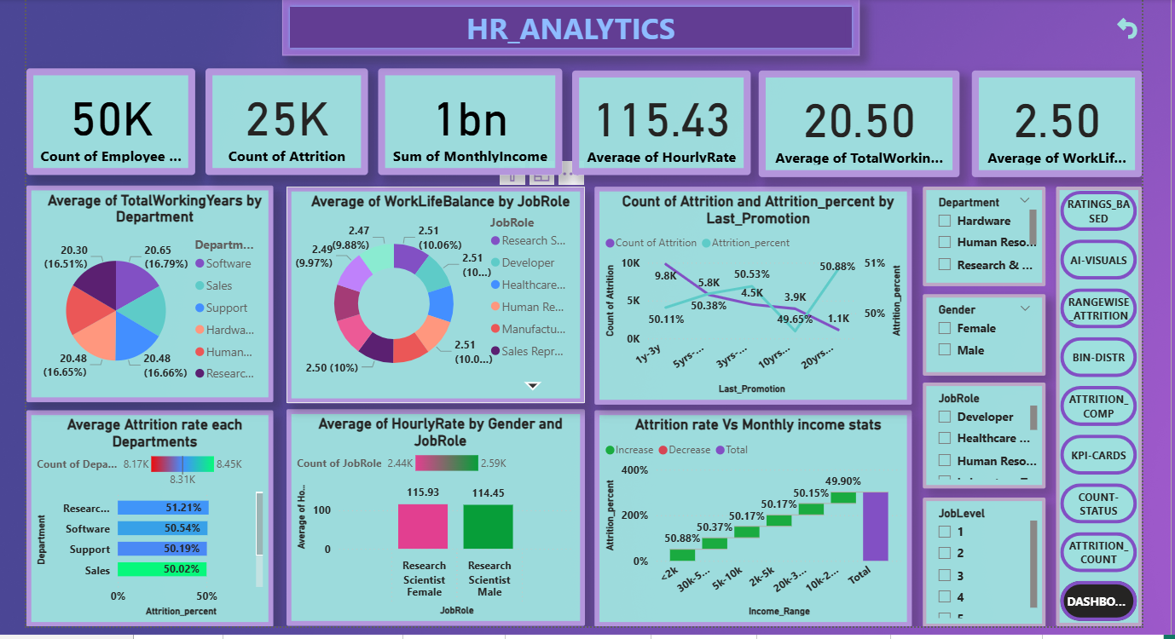
Power bi dashboard

Slide 7
Tableau HR Analytics
Tool: Tableau
Features:
Interactive filters.
Deviation from average analysis.
Department comparison dashboards.
Tableau HR Analytics – Insights:
Deviation from average highlights problem areas.
Promotion delays are strongly linked to employee attrition.
Attrition varies significantly across departments.
Clear visual comparison improves insight discovery.
Strong visual storytelling supports leadership decision-making.
Conclusion:
This dashboard provides an in-depth analysis of employee performance, compensation, experience, and satisfaction metrics.
It examines how attrition varies with hike percentage, promotion timelines, income ranges, and departmental tenure.

Slide 8
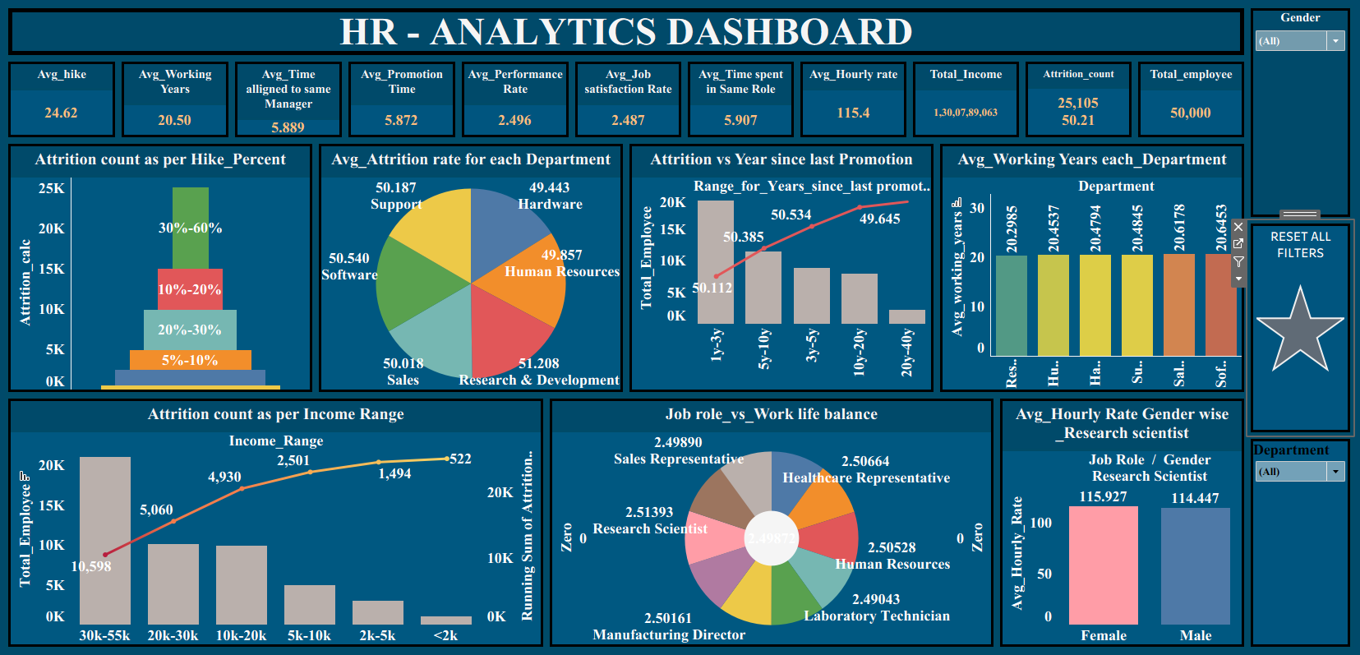
Tableau HR Analytics Dashboard

Slide 9
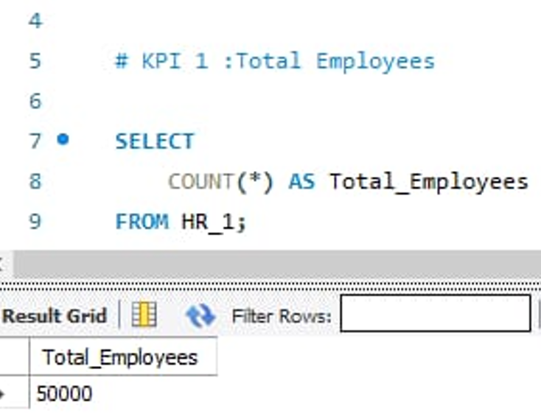
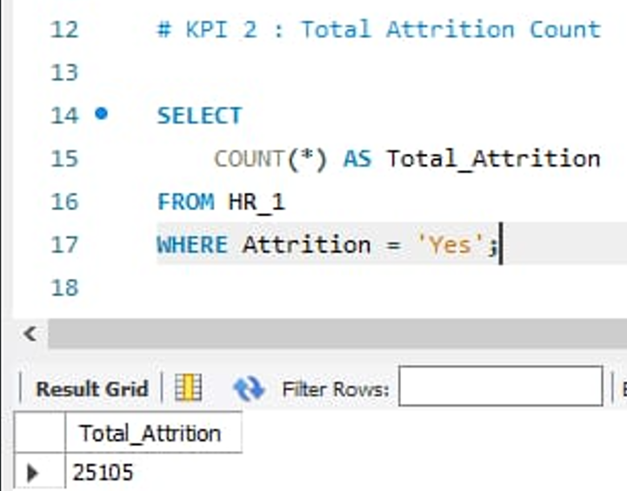
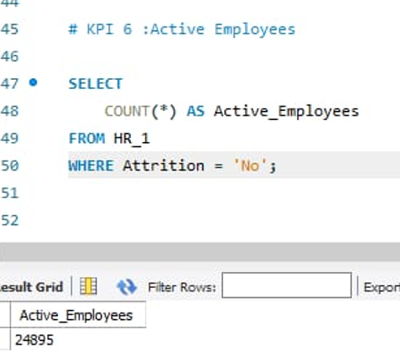
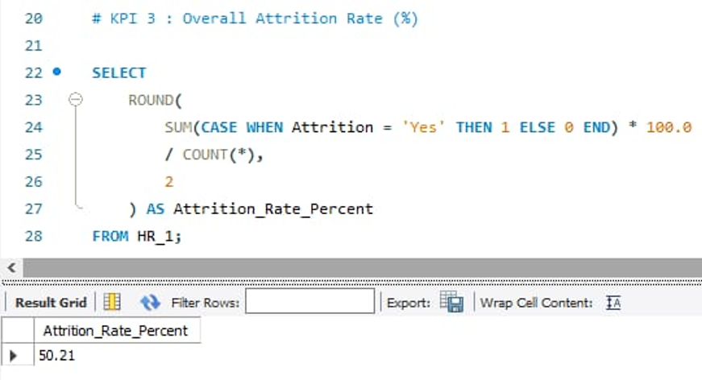
SQL Analytics – KPI Overview
Key KPIs calculated using SQL:
Total Employees: 50,000
Total Attrition Count: 25,105
Overall Attrition Rate: 50.21%
Active Employees: 24,895

Slide 10

SQL Analytics – key Insights
SQL KPI Validation – Insights :
SQL validates dashboard KPIs at source
Medium income band shows highest attrition.
Confirms consistency across BI tools.
Builds stakeholder trust.
Conclusion:
SQL was used to calculate and validate core HR KPIs directly from the database, ensuring accuracy and data reliability.
The SQL results confirm a high attrition level, with nearly half of the total employees leaving the organization.
These validated KPIs align with dashboard insights showing attrition patterns across departments, income ranges, and promotion timelines.
Combining SQL with Excel, Power BI, and Tableau strengthens confidence in the analysis and eliminates reporting inconsistencies.

Slide 11

End-to-end HR analytics using 4 tools. Consistent insights validated via SQL strong focus on business-driven decisions.
Conclusion:
Outcome:
Actionable HR insights & improved
Stakeholder-ready analytics storytelling.

Slide 12


